Slide 1
Novel Slot Detection Trong Hệ Thống Đối Thoại Hướng Nhiệm Vụ
Đồ Án Khoa Học Dữ Liệu & Ứng Dụng
GVHD: ThS. Nguyễn Văn Kiệt
Sinh Viên: Trần Triệu Vũ - 19522539
Võ Minh Trí - 19522396
Phạm Đức Thể - 19522253
Khoa Khoa học và Kỹ thuật thông tin
Bộ môn Khoa học dữ liệu

Slide 2
CONTENTS
Đồ Án Khoa Học Dữ Liệu & Ứng Dụng
Introduction
Input/output
Dataset
Model
Experiment and Result Analysis
Conclusion
Demo

Slide 3
Introduction
Đồ Án Khoa Học Dữ Liệu & Ứng Dụng
What is Slot filling?
Slot filling plays a vital role to understand user queries in personal assistants such as Alexa (Amazon), Siri (Apple), Google Assistant (Google), etc.
It aims at identifying a sequence of tokens and extracting semantic constituents from the user queries.
Given a large scale pre-collected training corpus, existing neural-based models have been actively applied to slot filling and achieved promising results.

Slide 4
Introduction
Đồ Án Khoa Học Dữ Liệu & Ứng Dụng
What is Novel Slot Detection?
A reliable slot filling model should not only predict the pre-defined slots but also detect potential unknown slot types to know what it doesn’t know, which we call Novel Slot Detection (NSD).
Novel Slot (NS) as new slot types that are not included in the pre-defined slot set.
NSD aims to discover potential new or out-of-domain (OOD) entity types to strengthen the capability of a dialogue system based on in-domain (IND) pre-collected training data.

Slide 5
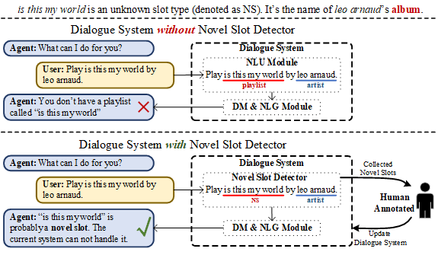
Input/output
Đồ Án Khoa Học Dữ Liệu & Ứng Dụng
An example of Novel Slot Detection in the task-oriented dialogue system.

Slide 6
Dataset
Đồ Án Khoa Học Dữ Liệu & Ứng Dụng
Dataset | train utterances | dev utterances | test utterance
Snips | 13,084 | 700 | 700
ATIS | 4,478 | 500 | 893
Notes:
Vì NSD không có dataset sẵn nên tác giả tạo nên 2 bộ dataset mới dựa trên 2 bộ dataset này.

Slide 7
Đồ Án Khoa Học Dữ Liệu & Ứng Dụng
Dataset
5%
15%
30%
Random select part of slot types in 2 dataset as unknown slots
For OOD intent detection, we just need to remove these sentences in training and validation set. However, for Novel Slot Detection, a sentence perhaps contains both in-domain slots and unknown slots, which is nontrivial for tackling unknown slots at the token level.

Slide 8
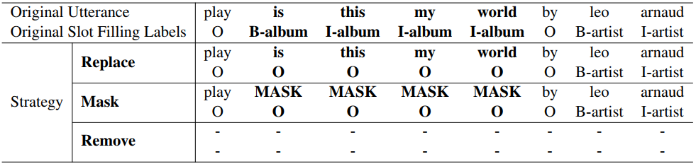
Dataset
Đồ Án Khoa Học Dữ Liệu & Ứng Dụng
Therefore, they propose three different processing strategies as follows:
Replace | Mask | Remove
Label the unknown slot values with all O in the training set while the original values remain unchanged. | Label the unknown slot values with all O and mask these slot values with a special token MASK. | All the sentences containing unknown slots are removed.
Notes:
replace: We label the unknown slot values with all O in the training set while the original values remain unchanged
mask: We label the unknown slot values with all O and mask these slot values with a special token MASK.
Remove:All the sentences containing unknown slots are directly removed

Slide 9
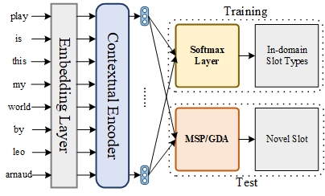
Model
Đồ Án Khoa Học Dữ Liệu & Ứng Dụng
In the training stage, we either train a multiple-class classifier or binary classifier using different training objective. We use public BERT-large embedding layer and BiLSTM-CRF for token level feature extraction. Then, in the test stage, we use the typical neural multiple classifier to predict the in-domain slot labels.
Meanwhile, we use the detection algorithm, MSP or GDA to figure out novel slot tokens. Finally, we override the slot token labels which are detected as NS.
Overall Framework

Slide 10
Đồ Án Khoa Học Dữ Liệu & Ứng Dụng
Model
Training objective:
In-domain slot
Multiple classifier | Binary classifier
Refers to the traditional slot filling objective setting | Non-O or O

Slide 11
Model
Đồ Án Khoa Học Dữ Liệu & Ứng Dụng
Training objective: in test stage
In-domain slot | Novel slot detection
Multiple classifier | Multiple classifier | Binary classifier | Multiple + Binary
Multiple + Binary: the token = “NS” only both classifiers predict it as NS.
Notes:
multiple classification:refers to the traditional slot filling objective setting, which performs token-level multiple classifications on the BIO tags combined with different slots

Slide 12
Model
Đồ Án Khoa Học Dữ Liệu & Ứng Dụng
Detection algorithm:
Maximum Softmax Probability | Gaussian Discriminant Analysis
The maximum falls below the threshold, the token will be predicted to be a NS token | Is a generative distancebased classifier for out-of-domain detection with Euclidean space.
Notes:
GDA:

Slide 13
Model
Đồ Án Khoa Học Dữ Liệu & Ứng Dụng
Distance strategy
In original GDA, when the Minimum distance is greater than a certain threshold, it is predicted to be “ns”.
Author propose a novel strategy named Difference, which uses the maximum distance minus the minimum distance, when the difference value of a target is less than a threshold, it is predicted as “ns”.

Slide 14
Experiment
Đồ Án Khoa Học Dữ Liệu & Ứng Dụng
Layers = 24
hidden states = 1024
Heads = 16
336M parameters
pre-trained Bert-large-uncased
BiLSTM
hidden size = 128
Optimizer: Adam
Lr = 2e-5
Dropout, batch size
Drop out = 0.5,
batch size = 256
Early stopping
Patience = 10

Slide 15
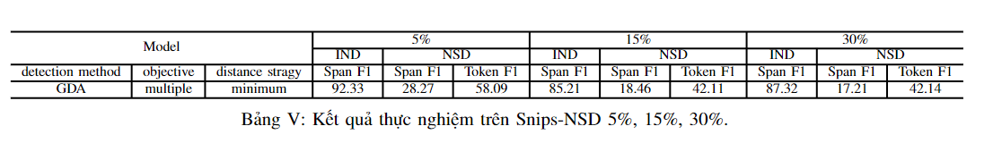
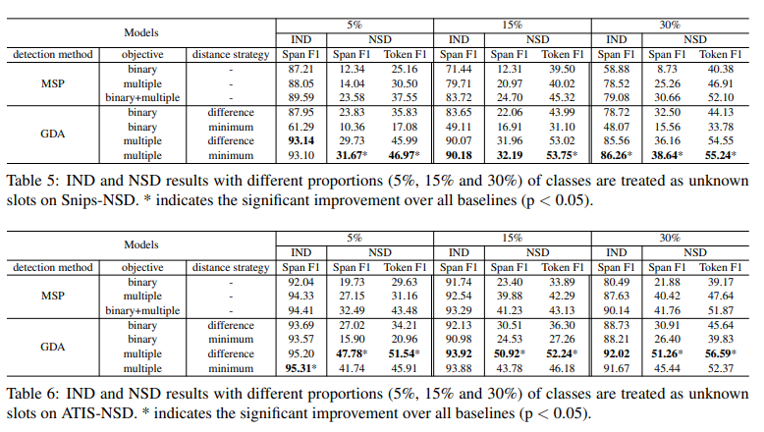
Result
Đồ Án Khoa Học Dữ Liệu & Ứng Dụng
Our
Author’s

Slide 16
Analysis
Đồ Án Khoa Học Dữ Liệu & Ứng Dụng
Tag O.
Open Vocabulary Slot.
Simmilar Slots.
1. Error.
2. Challenges.
Function tokens.
Insufficient context.
Dependencies between slots.
Open vocabulary slots.

Slide 17
Conclusion
Đồ Án Khoa Học Dữ Liệu & Ứng Dụng
Research about Novel Slot Detection.
Experiment on Snips-NSD.
Analysis the result, challenge and suggest development directions for future research.

Slide 18
Demo
Đồ Án Khoa Học Dữ Liệu & Ứng Dụng

Slide 19
Đồ Án Khoa Học Dữ Liệu & Ứng Dụng
Thanks for watching

